Slide 1

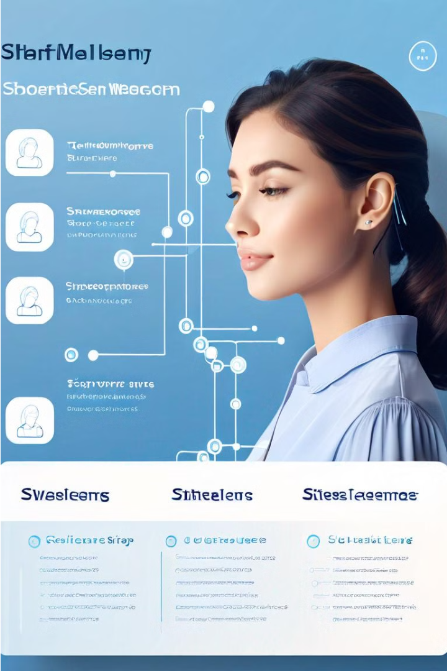
Analysis of Women Safety In Indian Cities Using Machine Learning On Tweets
This presentation will provide an in-depth look at leveraging machine learning techniques to analyze tweets and gain insights into women's safety in Indian cities. We will explore the objectives, existing systems, proposed solutions, and the technical architecture behind this innovative approach.

Slide 2
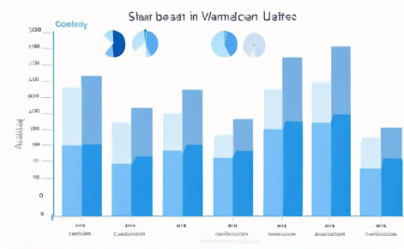


Objective
Analyze Women's Safety
Leverage Social Media Data
Propose Actionable Solutions
The primary objective of this project is to analyze the safety and security of women in major Indian cities using machine learning techniques on social media data.
The project aims to leverage social media data, particularly tweets, to gain insights into women's safety concerns and experiences in urban areas across India.
Based on the insights gathered, the project seeks to propose actionable solutions and recommendations to address the challenges faced by women in Indian cities.

Slide 3

Existing Systems
1
Reactive Reporting Systems
2
Siloed Data Collection
Existing systems rely on users to report incidents of women's safety concerns. This passive approach is limited in scope and often fails to proactively address underlying issues.
Current solutions gather data from various sources, but lack integration and analysis to derive meaningful insights on women's safety across cities.
3
Limited Geographical Coverage
Many existing systems focus on specific areas or cities, lacking a comprehensive, nationwide approach to address women's safety concerns.

Slide 4
Proposed System
Overview
Data Collection
Machine Learning Models
Real-Time Monitoring
The proposed system aims to leverage machine learning on Twitter data to analyze and monitor women's safety in Indian cities. It will collect and process relevant tweets to identify trends, hotspots, and potential safety concerns.
The system will continuously gather tweets related to women's safety, using keyword searches and geolocation data. This data will be filtered, cleaned, and structured for analysis.
The system will provide a dashboard for real-time monitoring of women's safety, highlighting hotspots, emerging issues, and other trends. This will enable authorities to respond quickly and effectively.
Advanced natural language processing and sentiment analysis models will be trained on the tweet data to detect safety-related issues, threats, and patterns. These models will provide insights and alerts to authorities.

Slide 5
System Requirements
Hardware
Software
Data Collection
High-performance servers to handle large-scale data processing and machine learning computations. Robust networking infrastructure to support real-time data streaming and analysis.
Powerful data mining and text analysis tools, such as natural language processing libraries. Reliable geolocation and mapping software to track incident locations. Scalable cloud-based storage and computing services.
Secure access to a large, diverse dataset of tweets related to women's safety in Indian cities. Ability to continuously monitor and extract relevant data in real-time.

Slide 6



Modules
Data Collection
Data Analysis
Visualization
Collect tweets related to women's safety in Indian cities. Leverage APIs and web scraping techniques to gather a diverse dataset.
Analyze the collected tweets using natural language processing and machine learning techniques to identify patterns, trends, and insights related to women's safety.
Develop interactive dashboards and visualizations to present the analysis findings, enabling stakeholders to better understand the women's safety landscape in Indian cities.

Slide 7

System Architecture
The proposed system architecture combines a robust data collection pipeline, advanced natural language processing models, and user-friendly visualization tools to enable comprehensive analysis of women's safety in Indian cities.
At the core of the system is a scalable, cloud-based data processing infrastructure that ingests and analyzes large volumes of social media data, incident reports, and other relevant data sources.
Machine learning algorithms power the sentiment analysis, topic modeling, and anomaly detection components, providing real-time insights and alerts to help authorities and citizens identify and address safety concerns.

Slide 8

Technical Architecture
The technical architecture for the proposed women's safety system leverages a range of cutting-edge technologies. It integrates natural language processing to analyze Twitter data, machine learning models to detect safety risks, and real-time alerting systems to notify authorities and users.
The backend is built on a scalable cloud platform, enabling the system to handle large volumes of data and traffic. The frontend provides a user-friendly interface for accessing safety information and reporting incidents.

Slide 9
Class Diagram and Sequence Diagram
The class diagram depicts the key classes and their relationships for the women's safety application. The sequence diagram illustrates the flow of interactions between the user, the application, and the machine learning model as tweets are analyzed to detect safety concerns.
These UML diagrams provide a comprehensive technical blueprint for the proposed system, enabling efficient development and ensuring the application meets the project's objectives.

Slide 10
Activity Diagram and Conclusion
1
Data Collection
Scrape tweets related to women's safety in Indian cities
2
Preprocessing
Clean and preprocess the tweet data
3
Sentiment Analysis
Analyze the sentiment of the tweets
4
Hotspot Identification
Identify high-risk areas for women's safety
The proposed system uses an activity diagram to illustrate the key steps involved in the analysis of women's safety in Indian cities using machine learning on tweets. The process starts with data collection, followed by preprocessing, sentiment analysis, and hotspot identification. This systematic approach helps to gain valuable insights from the online conversation around women's safety, which can inform policy and intervention strategies.
In conclusion, this project demonstrates the potential of leveraging social media data and machine learning to address the critical issue of women's safety in urban India. The insights generated can empower local authorities, community organizations, and the public to collaborate and take practical steps towards creating safer, more inclusive cities for all.

Slide 11
THANK YOU

